Slide 1

Working With Distributed Data
How To Separate Our Data Layer
SoftUni Team
Technical Trainers
Software University
https://softuni.bg

Slide 2
Table of Contents
The Bounded Context
Identifying Data Boundaries
Authentication And Authorization
Designing The Database

Slide 3
Questions
sli.do #microservices

Slide 4

The Bounded Context

Slide 5
The Bounded Context
Central pattern in DDD and Microservices
Its focus is dealing with large models by dividing them into logical groups
Bounded Contexts
The logical groups should be very explicit about their relationships

Slide 6
The Bounded Context
Each Bounded Context has
Unrelated concepts – such as support ticket in a customer support context
Related concepts – products and customers
Different context may have completely different models of common concepts
But may share the same data identity

Slide 7
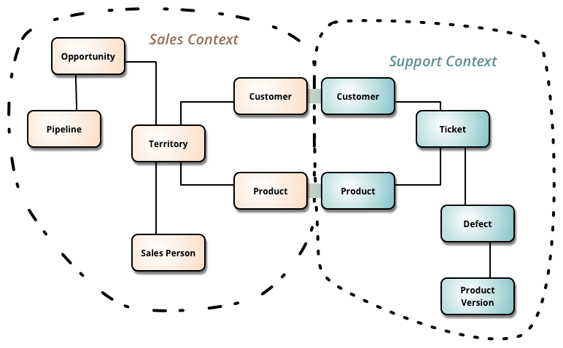
The Bounded Context

Slide 8
The Bounded Context
A microservice is like a Bounded Context
A separate process for each Bounded Context
With protocols for communication – HTTP, Web Sockets, or AMQP
Defining a microservice for each Bounded Context in your business domain is a good start
But don't be constrained by it
Sometimes a Bounded Context have multiple microservices

Slide 9
The Bounded Context
Just don't create nanocontext and nanoservices!
Do not think that each entity should be in a separate microservice
Also – it is perfectly fine to have the same model in multiple contexts
Make sure you split the properties properly
And do not overthink it!
Design is an evolving process!

Slide 10
Identifying Boundaries

Slide 11
Identifying Boundaries
The goal is not to make as granular microservices as possible
Nanoservices are bad!
The goal is to have the most meaningful separation
Cohesion is the key to separate the microservices

Slide 12
Identifying Boundaries
Keep in mind that finding the right “size” is not a one-shot process
The microservices will be continuously evolving
A common way is to split the contexts by the company’s social boundaries
But sometimes it may be the opposite
Duplicated data is completely OK!

Slide 13
Identifying Boundaries
Key results for success:
Few strong relationships between contexts
You don’t need to merge information for common processes
If you can work with a microservice without constantly switching to other microservices
Autonomous bounded context

Slide 14
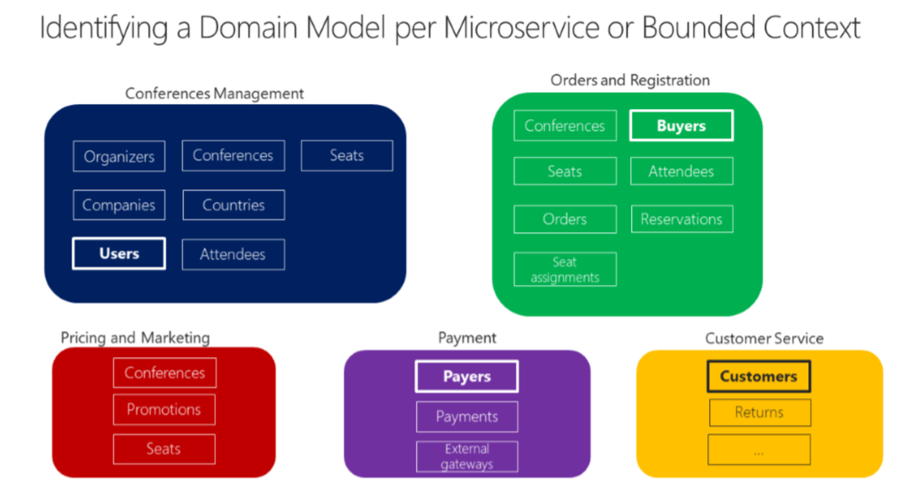
Identifying Boundaries

Slide 15
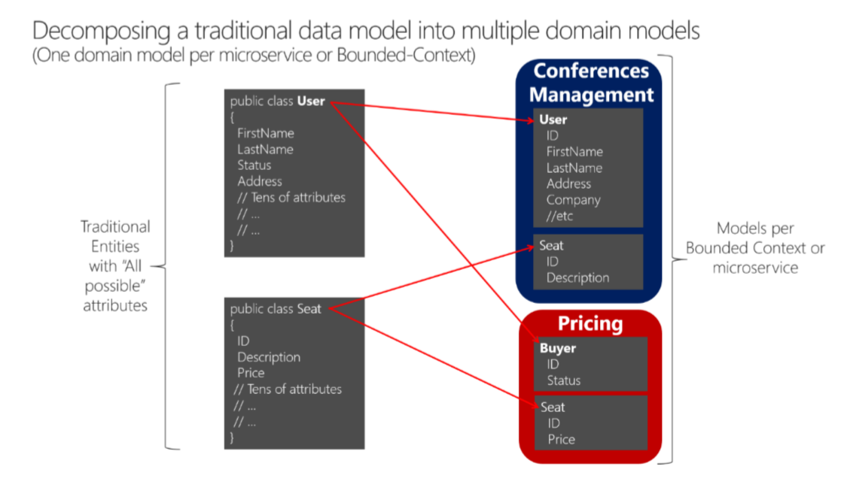
Identifying Boundaries

Slide 16
Authentication And Authorization

Slide 17
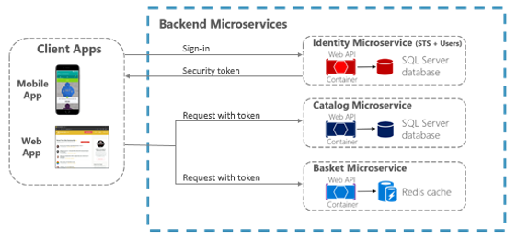
Authentication And Authorization

Slide 18
Designing The Database

Slide 19
Designing The Database
Atomic updates, transactions, consistency/referential integrity, and durability are extremely valuable
They should not be waived rashly
Your application must fill the gap with logic when your database technologies cannot guarantee ACID
Requires larger development effort
Clean code & integration testing is key!

Slide 20
Designing The Database
Key considerations:
Don't share databases or table ownerships
Duplicate data when needed
Heavy read queries with filtering and paging should be in the same context/database
Don’t be afraid to merge microservices, if the business requirements need it
There is no right or wrong approach if it is solving the domain problem

Slide 21
Designing The Database
Breaking relationships
Depending on the business requirements, it may be better do duplicate data instead of having a fictional foreign key
Start with foreign IDs and evolve accordingly
One-to-one and one-to-many need only an ID reference
Many-to-many relationships may require a separate microservice or a two additional tables

Slide 22

Summary
…
…
…
The Bounded Context
Identifying Data Boundaries
Authentication And Authorization
Designing The Database

Slide 23
Questions?
Notes:
23

Slide 24
Trainings @ Software University (SoftUni)
Software University – High-Quality Education, Profession and Job for Software Developers
softuni.bg, softuni.org
Software University Foundation
softuni.foundation
Software University @ Facebook
facebook.com/SoftwareUniversity
Software University Forums
forum.softuni.bg
Notes:
24

Slide 25

License
This course (slides, examples, demos, exercises, homework, documents, videos and other assets) is copyrighted content
Unauthorized copy, reproduction or use is illegal
© SoftUni – https://softuni.org
© Software University – https://softuni.bg
Notes:
25

